Slide 1
Web Essentials and Mark-up language -HTML
By Pradnya Lodha

Slide 2
What is Web Techonology?
Web technology is a technology that act as a interface between web client and web server.
It includes markup languages, programming interfaces, online presentation tools , java applets , video editing tools etc.
Client side scripting language – HTML,Javascript, CSS, XML and so o.
Server side scripting language – ASP,JSP, java Servlet, PHP and so on.

Slide 3
The Internet
The Internet is a massive network of networks, a networking infrastructure. It connects millions of computers together globally, forming a network in which any computer can communicate with any other computer as long as they are both connected to the Internet.
Using internet many people can share resources and can communicate with each other.
To have internet service one must go to the service providers. That means your computer must be connected to the internet service provider (ISP) through phone - line modem or DSL .

Slide 4
World Wide Web
It is a collection of websites or web pages stored in web servers and connected to local computers through the internet.
It is a information system in which various documents containing information are interlinked together. User can access this information or write the information via computers. These information typically stored on web pages and through web browser we can access web pages .
These websites contain text pages, digital images, audios, videos, etc.

Slide 5
History of the WWW
Tim Berners-Lee, a British scientist, invented the World Wide Web (WWW) in 1989, while working at CERN. The Web was originally conceived and developed to meet the demand for automated information-sharing between scientists in universities and institutes around the world.

Slide 6
Internet or WWW?
The internet is a collection of computers and other devices (sach as printer and scanner) connected together whereas WWW is collection of software and corresponding protocols used to access the resources over network
WWW contains huge amount of documents, images and other resources which can be accessed using the hyperlinks.
Thus people use internet through web.

Slide 7
Basic Internet Protocols:
The term “protocol” means in the context of networked communication. A computer communication protocol is a detailed specification of how communication between two computers will be carried out in order to serve some purpose.

Slide 8
1. File Transfer Protocol (FTP)
he File Transfer Protocol (FTP) is used to transfer files between two computers over a network and Internet.
Although transferring files from one system to another is very simple and straightforward, but sometimes it can cause problems.
For example, two systems may have different file conventions. Two systems may have different ways to represent text and data. Two systems may have different directory structures. FTP protocol overcomes these problems by establishing two connections between hosts. One connection is used for data transfer, and another connection is used for the control connection.

Slide 9
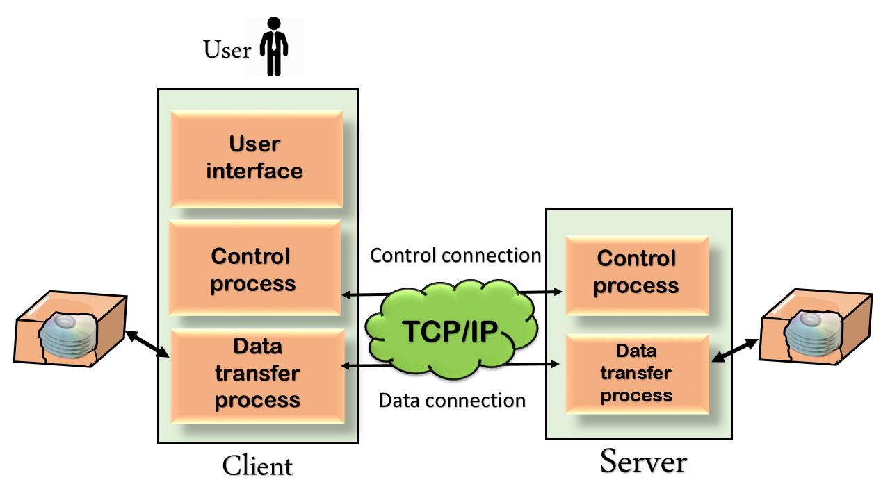
Mechanism of FTP

Slide 10
When clients make a request for particular file download then using the data transfer connection actual data gets transmitted from server to client.
At the same time server keeps track of how much data is sent so far and how much is remaining . This tracking can be done using the control transfer connection.
The above figure shows the basic model of the FTP. The FTP client has three components: the user interface, control process, and data transfer process. The server has two components: the server control process and the server data transfer process.

Slide 11
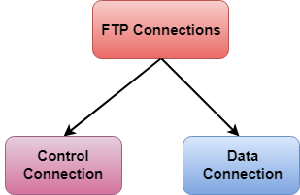
There are two types of connections in FTP:

Slide 12
HTTP
Hypertext Transfer Protocol (HTTP) is request/ response protocol.
It was designed for communication between web browsers and web servers, but it can also be used for other purposes.
HTTP follows a classical client-server model, with a client opening a connection to make a request, then waiting until it receives a response. HTTP is a stateless protocol, meaning that the server does not maintain the previous information.

Slide 13
SNMP
Simple Network Management Protocol (SNMP) is a networking protocol used for the management and monitoring of network-connected devices in Internet Protocol networks.
The network management system is based on two main elements : a supervisor and agents
The supervisor is the terminal at which the network administrator requests for network management.
The agents are found at the level of each interface connecting the managed devices to the network.with the help of these agent information on the different objects (such as switch, hub, router ) can be collected.

Slide 14
SMTP
The Simple Mail Transfer Protocol (SMTP) is an application used by mail servers to send, receive, and relay outgoing email between senders and receivers. As the technology behind email communication, SMTP is the protocol that allows you to send and receive emails.
It is a asynchronous protocol because it allows delayed delivery of message.

Slide 15
POP3
Post office protocol 3 is used by local email clients (such as Microsoft outlook express).
The POP3 protocol works only at receivers end and has no work at sender’s end.
The pop protocol has two parts ,client pop that is receiver pop and server pop that is receiver email server. The client that is receiver opens TCP connection with receivers pop server. This client must be authenticated first by using the user name and password. then the client can receive the emails from mailbox.

Slide 16
Transmission control Protocol (TCP)
TCP protocol is used for –
Safe delivery of data
Error detection
Assurance of the correct sequencing of data being received.
It is connection oriented protocol because before sending data this protocol require that two computer have establish connection

Slide 17
What is Internet Protocol (IP)? Internet Protocol is a method that is useful for sending data from one device to another from all over the internet. Every device contains a unique IP Address that helps it communicate and exchange data across other devices present on the internet.

Slide 18
Working of Transmission Control Protocol (TCP)
To make sure that each message reaches its target location intact, the TCP/IP model breaks down the data into small bundles and afterward reassembles the bundles into the original message on the opposite end. Sending the information in little bundles of information makes it simpler to maintain efficiency as opposed to sending everything in one go.
After a particular message is broken down into bundles, these bundles may travel along multiple routes if one route is jammed but the destination remains the same.

Slide 19
Working of Transmission Control Protocol (TCP)

Slide 20
TCP/IP
A key element of IP is the IP address, which is simply a 32-bit number. At any given moment, each device on the Internet has one or more IP addresses associated with it.
IP addresses are normally written as a sequence of four decimal numbers separated by periods (called “dots”), as in 192.0.34.166.
Each decimal number represents one byte of the IP address. The function of IP software is to transfer data from one computer (the source) to another computer (the destination).

Slide 21
UDP
The User datagram protocol is a connectionless protocol without any error detection facility.
This protocol is used for simply transmission of data.
The UDP is known as an unreliable protocol however this is much faster than TCP.

Slide 22
The web site design issue
Simplicity – Web design provide lot of animation, huge amount of information, extreme visual and so on. This make the web design enormous and it should be avoided. The web application must be moderate and simple.
Identity – web design must be based on the nature of the web application. A web engineer must work to establish an identify for the web application through the design.
Consistency - Website design consistency involves the systematic use of similar design elements and structures, such as color schemes, fonts, layouts, and navigation menus, to create a cohesive and intuitive user experience.

Slide 23
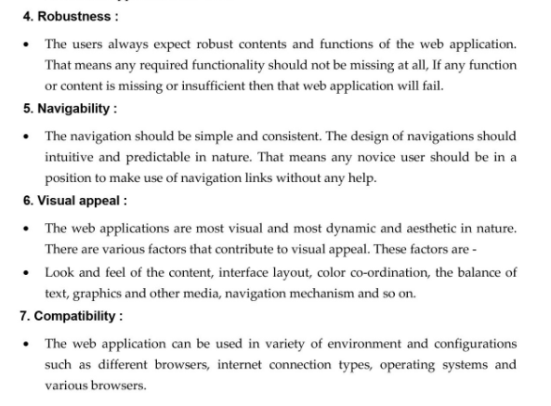

Slide 24
HTTP Request Message and Response Message
HTTP Protocol follows Request Response model.
Clients make a request for desired web page by giving the URL in address bar. This request is submitted to web server and then web server gives response to web browser by returning the required web page.

Slide 25
HTTP Request message structure
The request-response model defines a communication pattern where a client sends a request to a server, and the server responds with a corresponding response.

Slide 26
How Does a Request/Response model works?
< start line >
<Header Fields >
< Blank Line >
< Message Body >
<start line> consist of three parts which are separated by single space. These parts are – Request Method , Request URI , Request Version

Slide 27
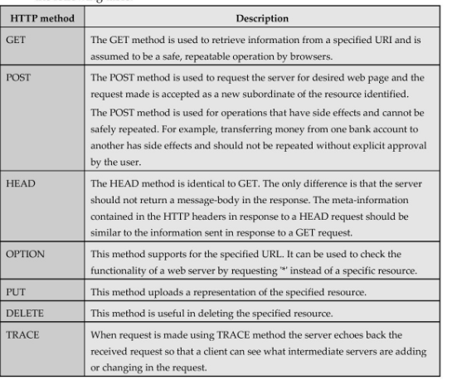
Request Method – Various methods are used for making the request are enlisted in the following table -

Slide 28
Request URI
The Uniform Resource Identifier (URI) is a string used to identify the names or resources of the internet.
URI is a combination of URL and URN.
URL stands for Uniform Resource Locator and URN stands for Uniform Resource Name.
The web address denote the URL and specific name of the place and person or item denotes the URN. For ex. ISBN 978-81-8431-123-2 specifies the address of some book.
If URI is written in the form of http: then it is both URI and URL, but there are some URI which can be also used as URL.

Slide 29
HTTP Version
First HTTP Version was HTTP/0.9 but the official version of HTTP/1.1
<Header Field> and <Message Body>
The host header field is associated with the HTTP request.
The header field are in the form of field name and field value.
Thus typical structure of HTTP request is given be following example.

Slide 30
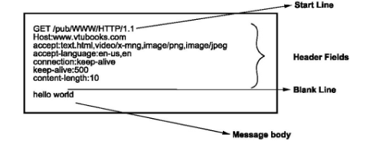
HTTP Request Message Structure

Slide 31
HTTP Response Message structure
<Status line>
<Header Fields>
<Blank line>
<Message body>
Status line is similar to the start line in request message. It consist of three fields.
HTTP Version
Status Code
Reason Phrase

Slide 32
HTTP version denote HTTP version such as HTTP/1.1.
The status code is a numeric code indication the type of response.
The Reason Phrase is in the text string from and presents the information about the status code
HTTP / 1.1 200 OK
HTTP Version Status Code Reason Phrase

Slide 33
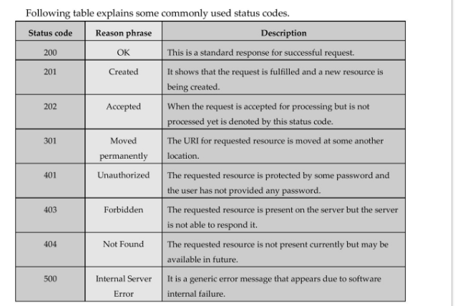

Slide 34
<Header Fields> - The Header field in response message is similar to that of request message.
<Message Body> - The message body consist of response message.

Slide 35
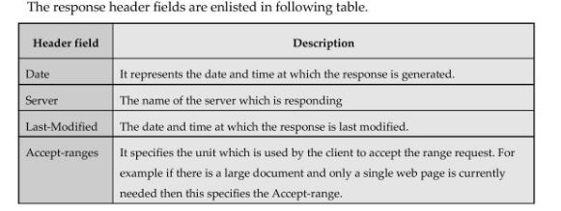

Slide 36
Features of HTTP Protocol
It is commutation protocol used between web browser and web server.
This protocol based on request – response messaging. This means client makes a request of desired web page and then the server responds it by sending the requested resource.
It is a stateless protocol. That means HTTP protocol can not remember the previous user’s information nor it remembers the number of times user has visited particular website
The request-response message consists of plain text in fairly readable form.
The HTTP Protocol has a cache control. This is very useful feature because if the user requests the same web page that has been visited already then it can be displayed from the cache memory instead of requesting the web server and bringing it from there.

Slide 37
Web clients
A web client is a client-side application used for connecting to a web server over HTTP.
It is typically a web browser or web app which displays web pages received from the server and allows users to interact with the web server.
Without these clients, an ordinary user can’t use the internet. When you search for a particular webpage through your browser, it retrieves the page from the appropriate server and displays the result. The client and server communicate via HTTP(Hypertext Transfer Protocol).

Slide 38
Web Browser
When we need any kind of information most of the time we get help from the Internet, and we get information.
The Internet provides us with useful information easily.
We use mobile phones, computers, and tablets. We search for a lot of things in our daily lives, so we get information about all over the world, but we can not get information by just only getting connected to the Internet.
We need a platform where we can search for our questions. The platform that provides such kinds of services is called a web browser, without a web browser internet will not be able to provide information.

Slide 39
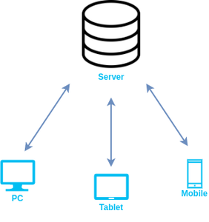
How does a Web Browser Work?

Slide 40
A web browser helps us find information anywhere on the internet. It is installed on the client computer and requests information from the web server such a type of working model is called a client-server model.
The browser receives information through HTTP protocol. In which transmission of data is defined. When the browser received data from the server, it is rendered in HTML to user-readable form and, information is displayed on the device screen.

Slide 41
Some Popular Web Browsers
1. Google Chrome:
2. Mozilla Firefox:
3. Apple Safari:
4. Microsoft Edge:
5. Tor Browser:
6. Opera:
7. Brave:

Slide 42
URL
A URL (Uniform Resource Locator) is a unique identifier used to locate a resource on the Internet. It is also referred to as a web address. URLs consist of multiple parts -- including a protocol and domain name -- that tell a web browser how and where to retrieve a resource.
The URL contains the name of the protocol needed to access a resource, as well as a resource name. The first part of a URL identifies what protocol to use as the primary access medium. The second part identifies the IP address or domain name -- and possibly subdomain -- where the resource is located.

Slide 43
URL protocols include HTTP (Hypertext Transfer Protocol) and HTTPS (HTTP Secure) for web resources, mail to for email addresses, FTP for files on a File Transfer Protocol (FTP) server, and telnet for a session to access remote computers. Most URL protocols are followed by a colon and two forward slashes; "mail to" is followed only by a colon.

Slide 44
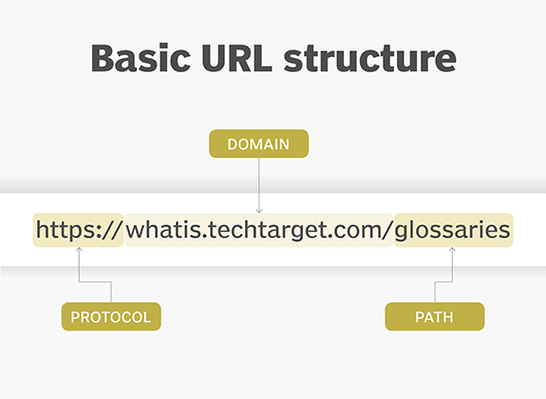

Slide 45
Parts of a URL
The protocol or scheme. Used to access a resource on the internet. Protocols include http, https, ftps, mailto and file. The resource is reached through the domain name system (DNS) name. In this example, the protocol is https.
Host name or domain name. The unique reference the represents a webpage. For this example, whatis.techtarget.com.

Slide 46
Absolute and relative URL
The absolute URL is a URL which directly point to a file
It exactly specifies exact location of a file or directory on the internet. Each absolute URL is unique
Ex -http://www.example.com/xyz.html>
The relative URL points the file or directory in a relation to the present directory. An example of a relative URL is:
<a href = "/xyz.html">

Slide 47
Web Servers
Web server is a special type of server to which the web browser submits the request of web page which is desired by the client.
The main job of a web server is to display website content through storing, processing and delivering webpages to users. Besides HTTP, web servers also support SMTP (Simple Mail Transfer Protocol) and FTP (File Transfer Protocol), used for email, file transfer and storage.

Slide 48
Functions of a Web Server
Storing and delivering web content:The primary function of a web server is to store and deliver web content such as web pages, images, videos, and other files to clients that request them
Handling HTTP requests:A web server handles HTTP (Hypertext Transfer Protocol) requests from clients or users. The HTTP protocol is the standard protocol used for communication between web servers and clients

Slide 49
Generating responses to HTTP requests: A web server generates responses to HTTP requests by running web applications that generate dynamic content based on user input and other factors. For example, an e-commerce website may use a web application to generate web pages dynamically that display product information, pricing, and availability based on user searches or selections.
Managing and maintaining web applications: web server manages and maintains web applications that provide various services such as e-commerce, social networking, and content management.
Supporting multiple clients simultaneously: A web server supports multiple clients or users simultaneously by handling multiple HTTP requests at the same time

Slide 50
How Does a Web Server Work?
Here’s a basic overview of how a web server works:
The client device (e.g., a web browser) sends a request to the web server for a particular resource, such as a web page.
The web server receives the request and processes it, checking if the requested resource exists and is accessible.
If the resource is available, the web server retrieves it and sends it back to the client’s device as a response.
The client device receives the response and displays the resource (e.g., web page) to the user.

Slide 51
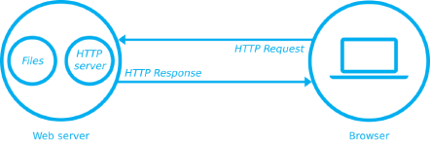
How Does a Web Server Work?

Slide 52
Types of Web Servers
Apache HTTP Server: Apache HTTP Server is an open-source web server software that is widely used around the world. It is known for its high performance, stability, and flexibility, and supports a wide range of operating systems, including Linux, Windows, and macOS.
Microsoft Internet Information Services (IIS): IIS is a web server software developed by Microsoft that is designed to run on Windows operating systems. It is known for its scalability, security features, and support for Microsoft technologies such as ASP.NET and Microsoft SQL Server.

Slide 53
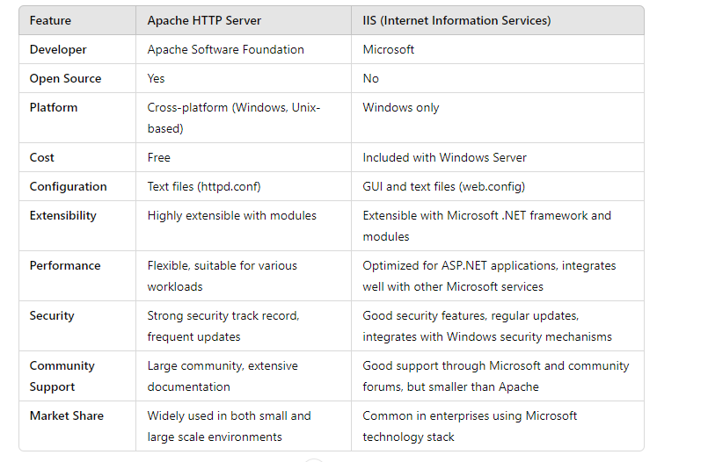
Difference of Apache HTTP Server and IIS web server

Slide 54
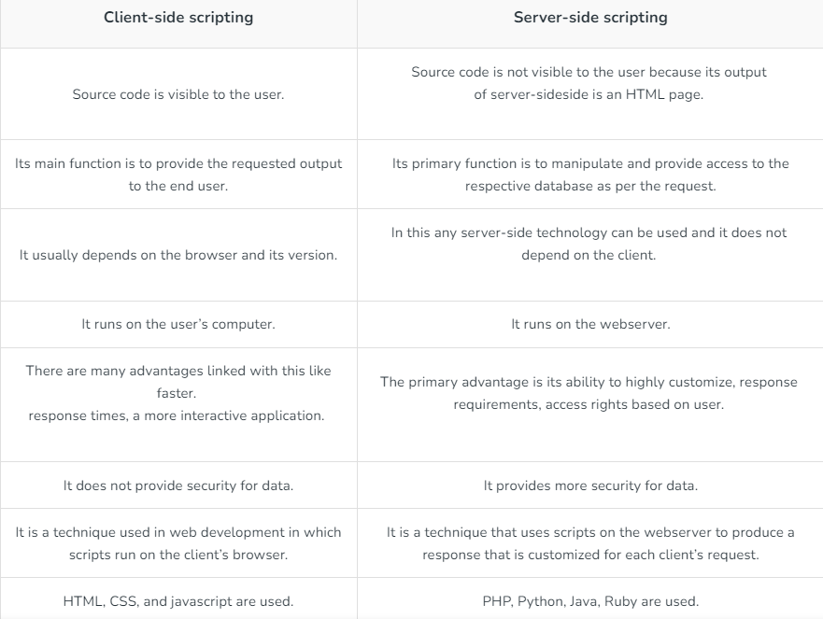
client side scripting and client side scripting

Slide 55
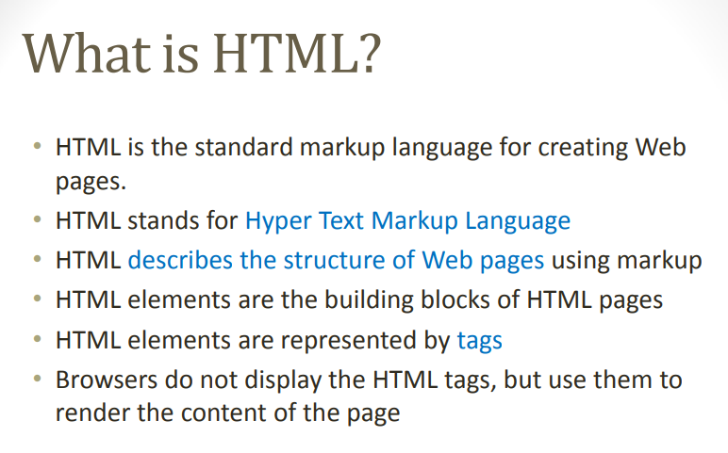
HTML

Slide 56
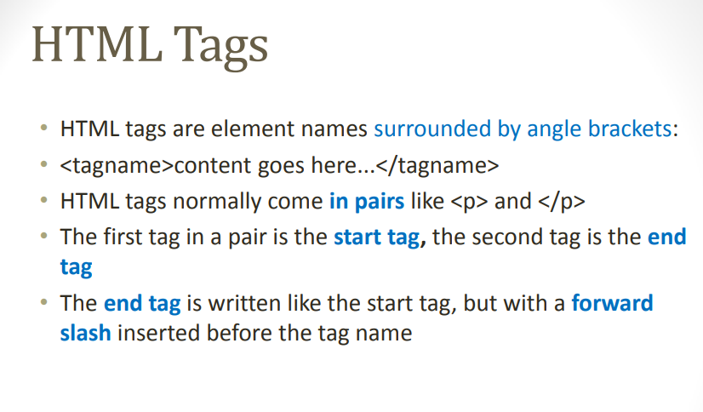

Slide 57
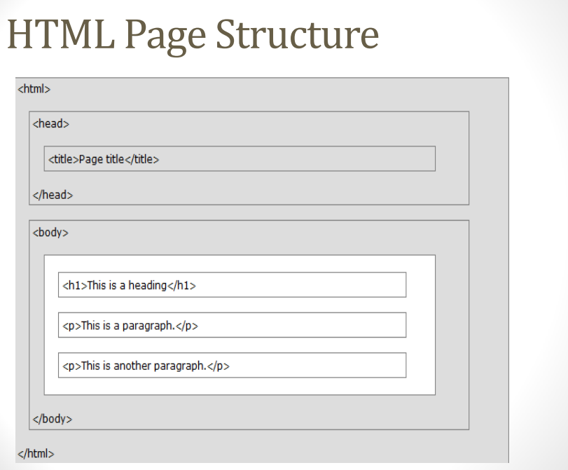

Slide 58
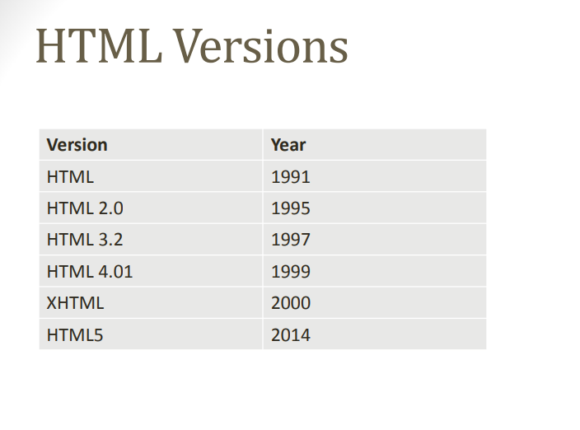

Slide 59
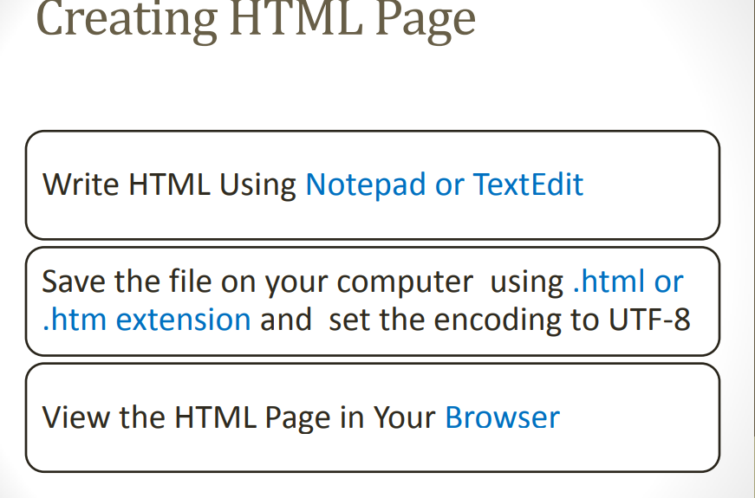

Slide 60
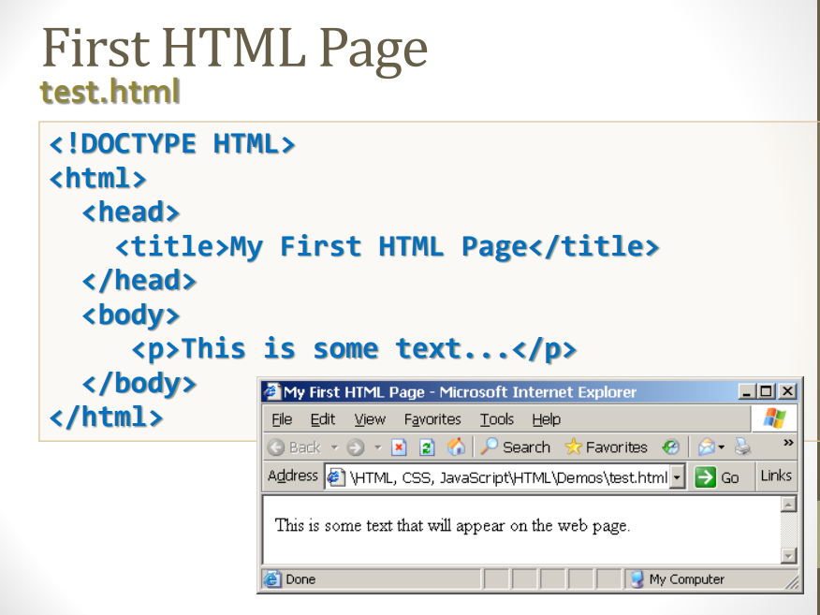

Slide 61
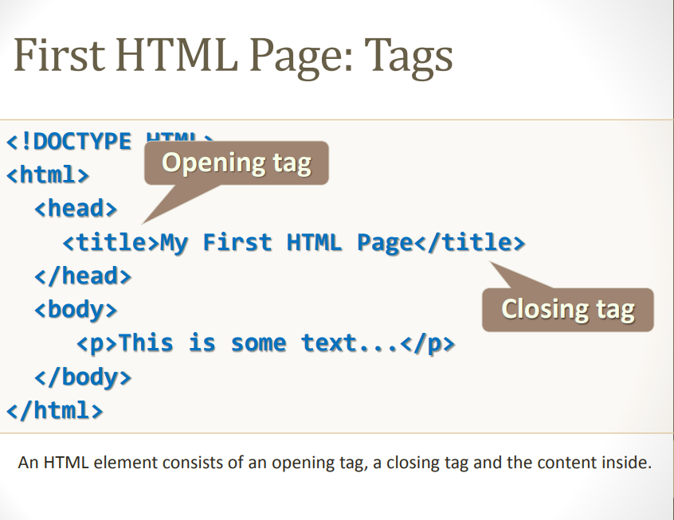

Slide 62
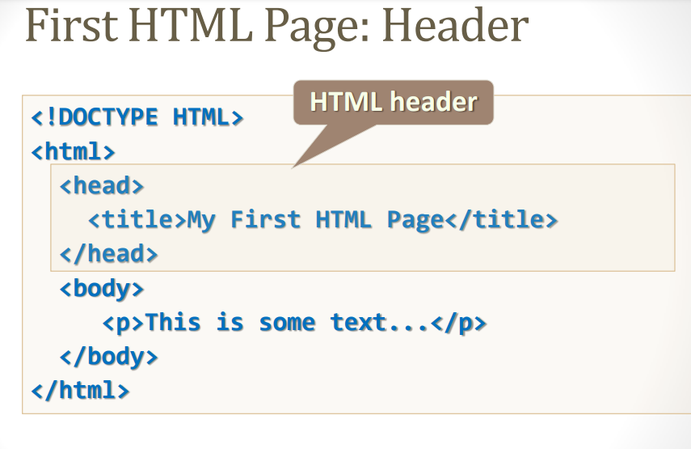

Slide 63
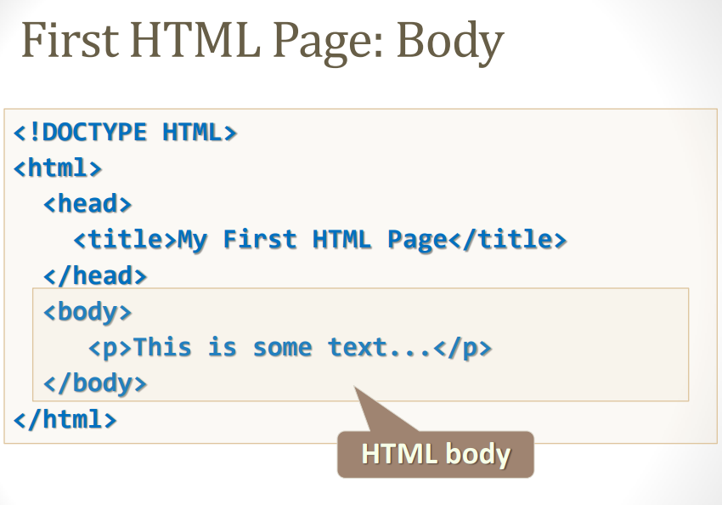

Slide 64
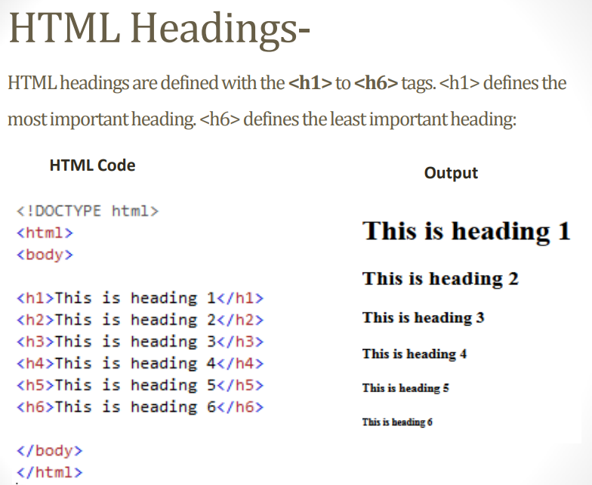

Slide 65
Paragraphs
The <p> tag defines a paragraph.
Browsers automatically add a single blank line before and after each <p> element.
Text in a <pre> element is displayed in a fixed-width font, and the text preserves both spaces and line breaks.
<div> this tag is used to make division of section in the XHTML document
Try - https://www.w3schools.com/html/html_paragraphs.asp

Slide 66
Text Formatting
Formatting elements were designed to display special types of text:
<b> - Bold text
<strong> - element defines text with strong importance. The content inside is typically displayed in bold.
<i> - Italic text
<em> - Emphasized text, The content inside is typically displayed in italic.
<mark> - defines text that should be marked or highlighted:
<small> - Smaller text
<del> - Deleted text
<ins> - Inserted text
<sub> - Subscript text appears half a character below the normal line, and is sometimes rendered in a smaller font. Subscript text can be used for chemical formulas, like H₂O:
<sup> - Superscript text appears half a character above the normal line, and is sometimes rendered in a smaller font. Superscript text can be used for footnotes, like WWW^{[1]}
Try - https://www.w3schools.com/html/html_formatting.asp

Slide 67
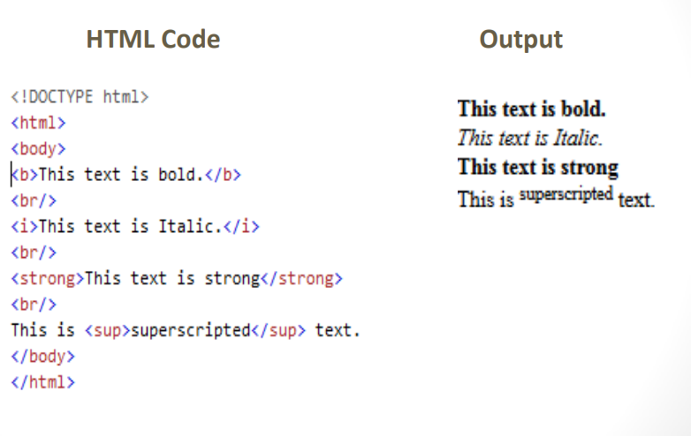
Text Formatting Example

Slide 68
Setting font and colour
HTML font color attribute specifies the text color of content inside the <font> tag. The font color attribute accepts a color value that we want to apply to a text and it will be displayed on the screen having that mentioned color.
<font color="color_name|hex_number|rgb_number">
Attribute Values:
color_name: It sets the text color by using the color name. For example: “red”.
hex_number: It sets the text color by using color hex code. For example: “#0000ff”.
rgb_number: It sets the text color by using rgb code. For example: “rgb(0, 153, 0)”.
Try - https://www.w3schools.com/html/html_colors.asp

Slide 69
HTML Links - Syntax
The HTML <a> tag defines a hyperlink. It has the following syntax:
<a href="url">link text</a>
The most important attribute of the <a> element is the href attribute, which indicates the link's destination.
The link text is the part that will be visible to the reader.
DETAILS -https://www.w3schools.com/html/html_links.asp

Slide 70
Frames
To make frames on a page we use <frameset> tag instead of <body> tag. The <frameset> tag defines how to divide the window into frames. The rows attribute of <frameset> tag defines horizontal frames and cols attribute defines vertical frames. Each frame is indicated by <frame> tag and it defines which HTML document shall open into the frame.
Try - https://www.geeksforgeeks.org/html-frame-tag/?ref=lbp

Slide 71
HTML Lists
An unordered list starts with the <ul> tag. Each list item starts with the <li> tag
Unordered HTML List - An unordered list starts with the <ul> tag. Each list item starts with the <li> tag.
Ordered HTML List - An ordered list starts with the <ol> tag. Each list item starts with the <li> tag.
HTML Description Lists - The <dl> tag defines the description list, the <dt> tag defines the term (name), and the <dd> tag describes each term
Ex - https://www.w3schools.com/html/html_lists.asp

Slide 72
Table
A table in HTML consists of table cells inside rows and columns.
Each table cell is defined by a <td> and a </td> tag.
td stands for table data.
Everything between <td> and </td> are the content of the table cell.
Each table row starts with a <tr> and ends with a </tr> tag.
tr stands for table row.
th stands for table header.
Ex - https://www.w3schools.com/html/html_tables.asp

Slide 73
Images
The HTML <img> tag is used to embed an image in a web page.
Images are not technically inserted into a web page; images are linked to web pages. The <img> tag creates a holding space for the referenced image.
The <img> tag is empty, it contains attributes only, and does not have a closing tag.
The <img> tag has two required attributes:
src - Specifies the path to the image
alt - Specifies an alternate text for the image
Ex. - https://www.w3schools.com/html/html_images.asp

Slide 74
Features of HTML:
It allows the creation of hyperlinks with the <a> tag, connecting different web pages.
Uses tags to mark elements and content, such as headings (<h1> to <h6>).
It supports embedding images (<img>), videos (<video>), and audio (<audio>) for multimedia content.
It provides form elements like <form>, <input>, and <button> for user input and data submission.
Semantic tags like <article>, <section>, and <nav> for better document structure and accessibility.

Slide 75
Features of HTML5
Introduced new semantic elements like <header>, <footer>, <section>, and <article> for improved structure.
Enhances multimedia capabilities with native support for audio and video elements.
Provides the localStorage API, allowing web applications to store data locally on the user’s device.
Enables websites to access a user’s geographical location.
Uses SQL database to store data offline.

Slide 76
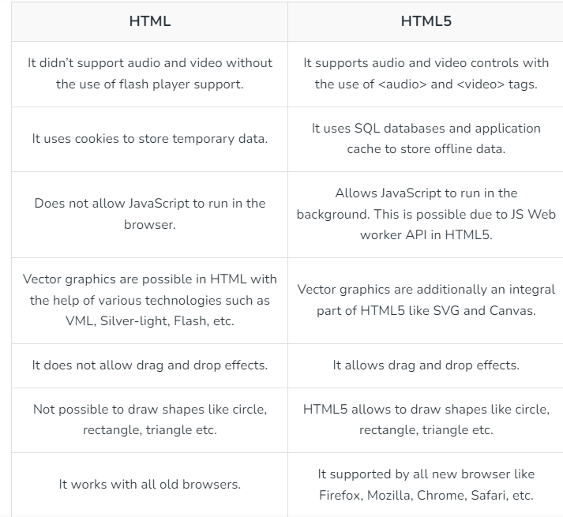
Difference between HTML and HTML5

Slide 77
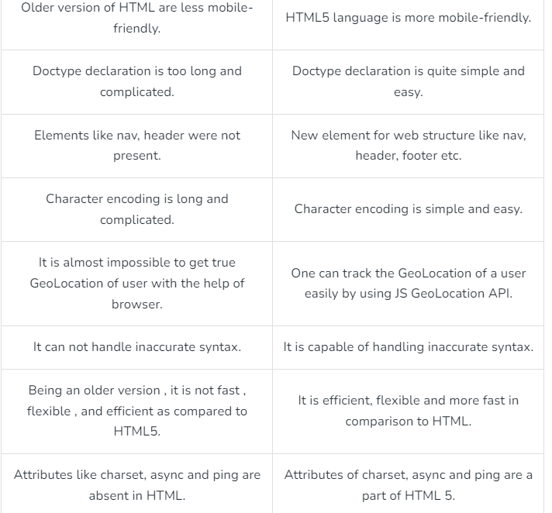
Difference between HTML and HTML5

Slide 78
What is CSS
CSS stands for Cascading Style Sheets
CSS describes how HTML elements are to be displayed on screen, paper, or in other media
The CSS is a markup language used in the web document for presentation purpose.
The primary intension of CSS was to separate out the web content from the web presentation
CSS saves a lot of work. It can control the layout of multiple web pages all at once
Cascading Style Sheets, fondly referred to as CSS, is a simple design language intended to simplify the process of making web pages presentable.
CSS handles the look and feel part of a web page.
Using CSS, you can control the color of the text, the style of fonts, the spacing between paragraphs, how columns are sized and laid out, what background images or colors are used, layout designs , variations in display for different devices and screen sizes as well as a variety of other effects
Try - https://www.w3schools.com/css/css_syntax.asp

Slide 79
Advantages of CSS
CSS saves time
Pages load faster
Easy maintenance
Superior styles to HTML
Multiple Device Compatibility
Global web standards
Offline Browsing
Platform Independence
Flexibility
Try - https://www.w3schools.com/css/css_selectors.asp

Slide 80
CSS - Syntax
For inline cascading style sheets the style appears in side the tag for defining the values
<p style = “font.size: 30pt ;font-family:Script”>
For the document cascading style sheet the style specification appear as the content of a style element within the header of a document.
Style rule is made of three parts −
Selector − A selector is an HTML tag at which a style will be applied. This could be any tag like h1,h2,table or etc.
Property - A property is a type of attribute of HTML tag. Put simply, all the HTML attributes are converted into CSS properties. They could be color, border, fonts,text,colour background etc
Value - Values are assigned to properties. For example, color property can have value either red or #F1F1F1 etc

Slide 81
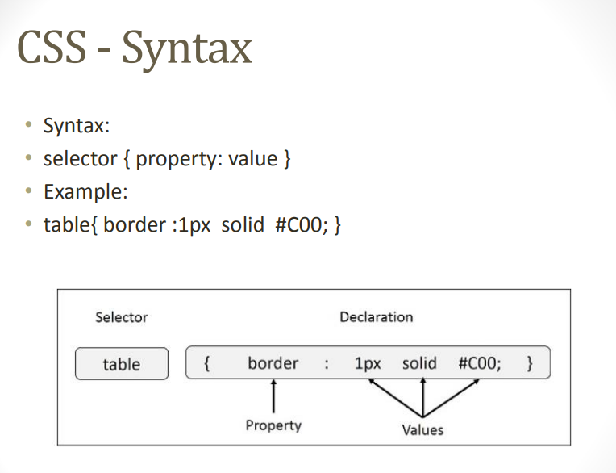

Slide 82
CSS selectors (1)
CSS selectors are used to "find" (or select) HTML elements based on their element name, id, class, attribute, and more.
The element Selector
The element selector selects elements based on the element name.
You can select all elements on a page like this (in this case, all elements will be center-aligned, with a red text color):
Example
p {
text-align: center; color: red;
}

Slide 83
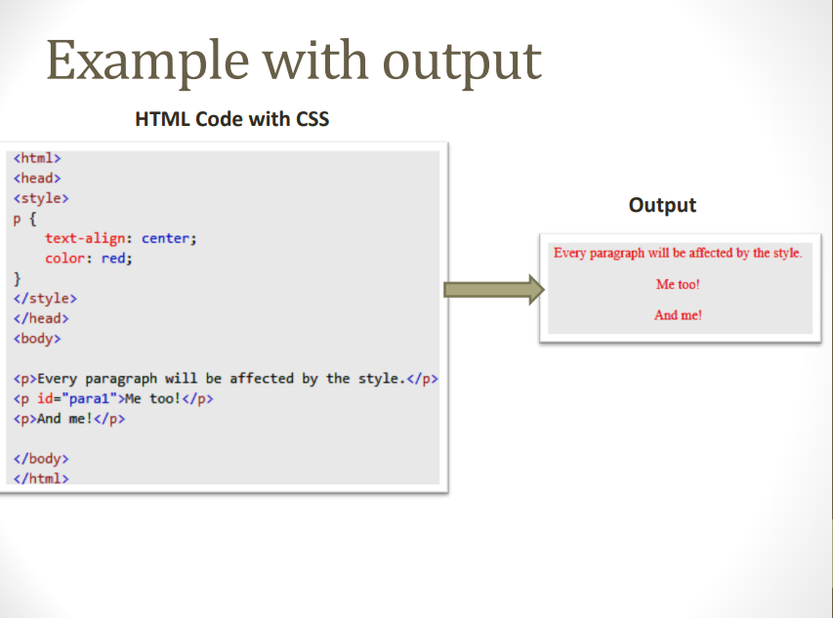

Slide 84
CSS selectors (2)
The id Selector -
The id selector uses the id attribute of an HTML element to select a specific element.
The id of an element should be unique within a page, so the id selector is used to select one unique element!
To select an element with a specific id, write a hash (#) character, followed by the id of the element.
The style rule below will be applied to the HTML element with id="para1":
Example #para1 { text-align: center; color: red; }

Slide 85
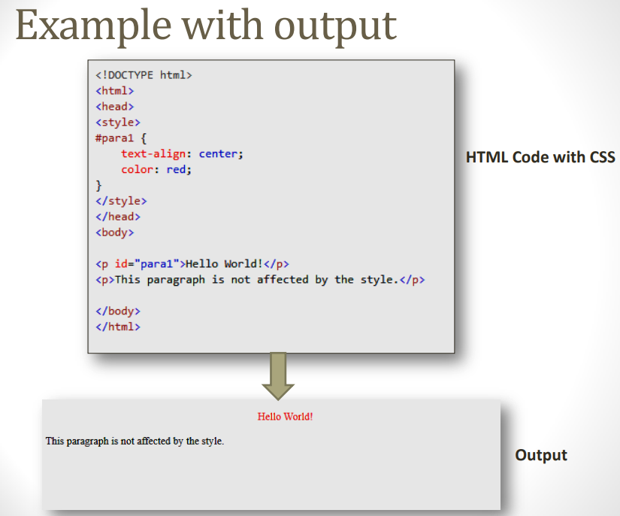

Slide 86
CSS selectors (3)
The class Selector
The class selector selects elements with a specific class attribute.
To select elements with a specific class, write a period (.) character, followed by the name of the class.
In the example below, all HTML elements with class="center" will be red and center-aligned: Example
.center
{
text-align: center;
color: red;
}

Slide 87
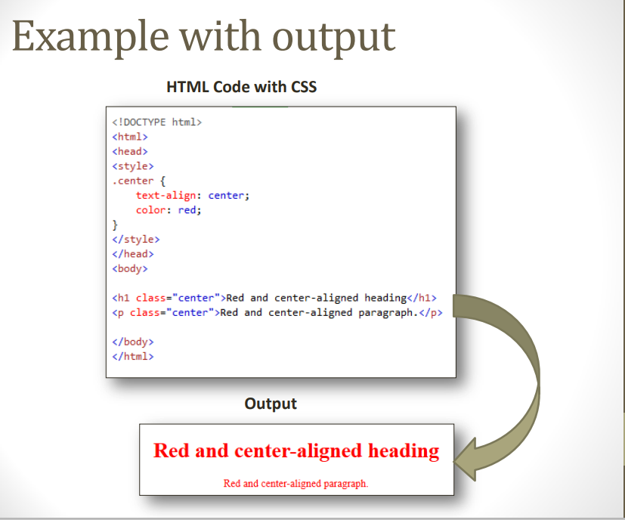

Slide 88
CSS selectors (4)
The class Selector continued….
You can also specify that only specific HTML elements should be affected by a class.
In the example below, only elements with class="center" will be center-aligned:
Example - p.center
{
text-align: center; color: red;
}

Slide 89
CSS selectors (5)
Grouping Selectors
If you have elements with the same style definitions, like this:
h1
{
text-align: center; color: red;
}
h2
{ text-align: center; color: red;
}
p {
text-align: center; color: red;
}
It will be better to group the selectors, to minimize the code.
h1, h2, p
{
text-align: center; color: red;
}

Slide 90
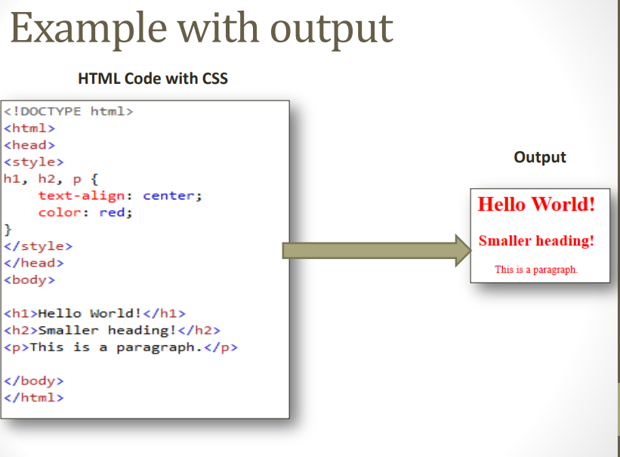

Slide 91
Insert CSS in HTML
• Three Ways to Insert CSS
1. External style sheet
2. Internal style sheet
3. Inline style
Example https://www.w3schools.com/html/html_css.asp

Slide 92
Style rule cascading and inheritance
The CSS cascade and inheritance module defines the rules for assigning values to properties by way of cascading and inheritance. This module specifies the rules for finding the specified value for all properties on all elements. One of the fundamental design principles of CSS is cascading of rules

Slide 93
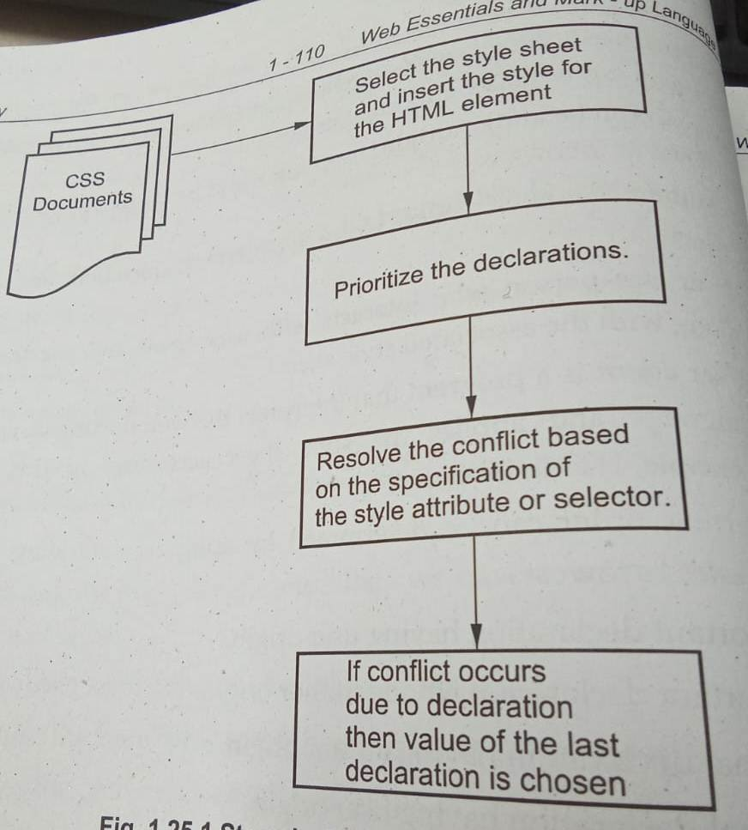
Steps in CSS cascade

Slide 94
Inheritance
In HTML document, the tags have parent-child relationships. For ex. <title> tag is always inside the <head> tag, so the <head> tag is the parent of the <title>. Similarly <p> tag is defined inside the<body> tag. Then <body> becomes parent of <p>.
In cascading style sheets, inheritance is based on tree structure of the document itself.
Inheritance can be defined as a concept in which child always inherits the properties of parent tag along with its own properties.

Slide 95
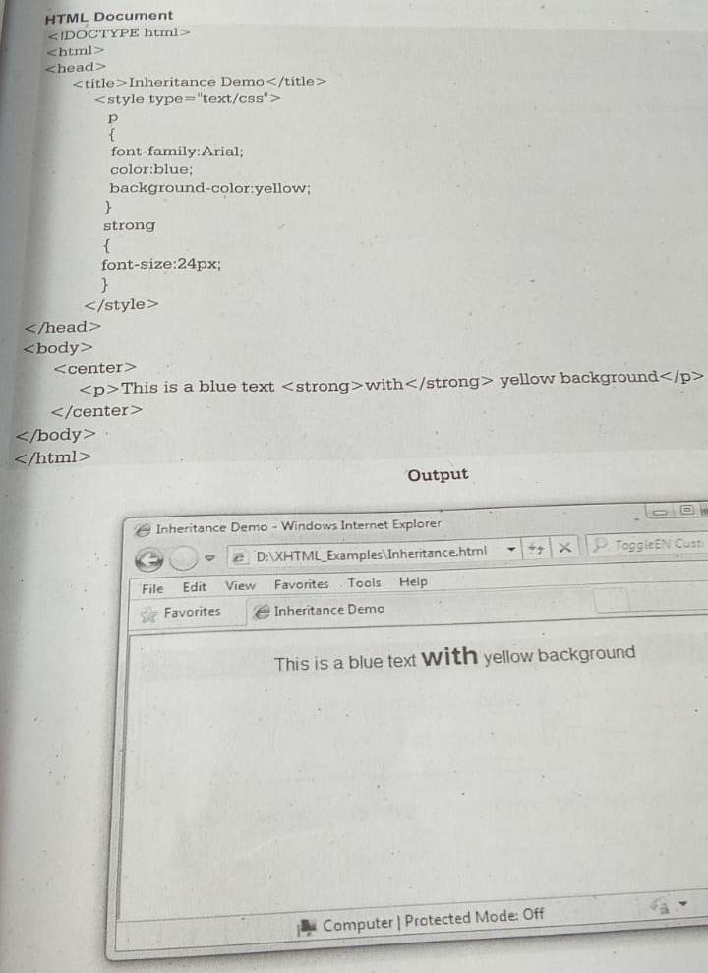

Slide 96
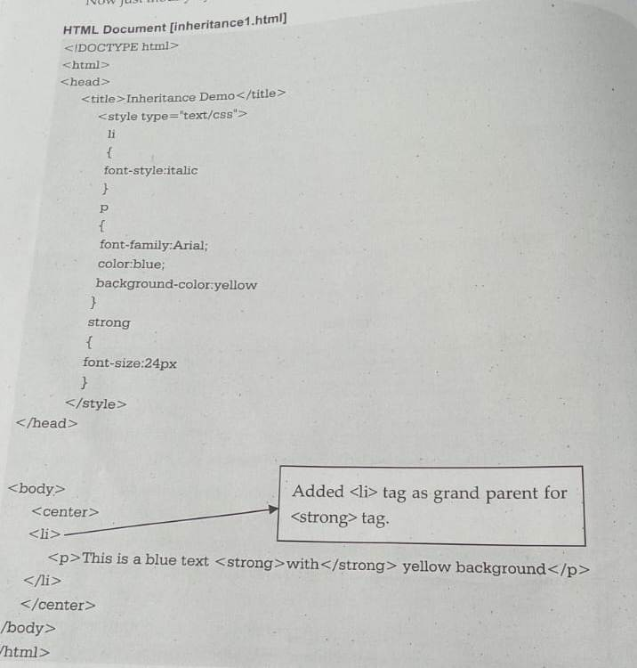

Slide 97
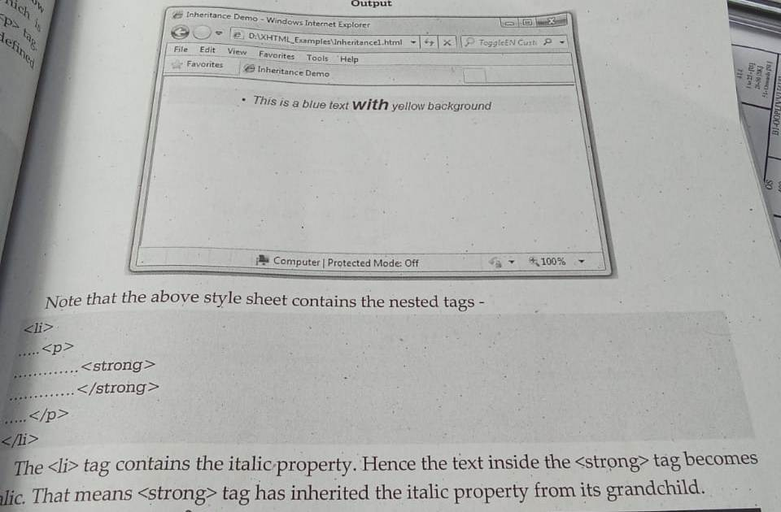

Slide 98
CSS font families
The font family denotes different types of fonts such as Arial,Times New Roman and so on.

Slide 99
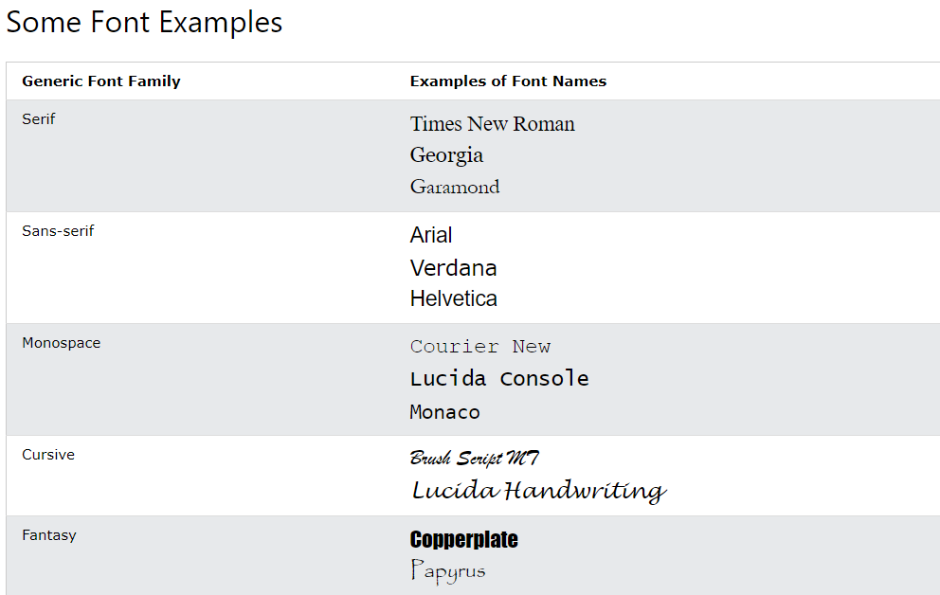

Slide 100
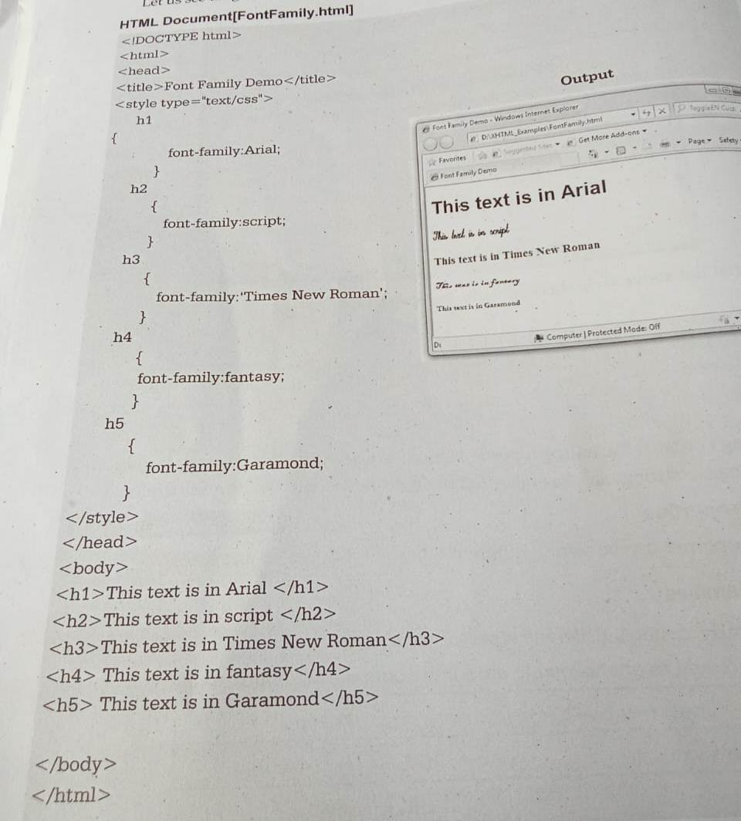

Slide 101
Font Size
https://www.w3schools.com/css/css_font_size.asp

Slide 102
Font Variants
The font-variant property is used to convert all lowercase letters into uppercase letters. But the converted upper letters appear too small font-size than the original uppercase letters.
normal: It has a default value. It specifies a normal font-size.
small-caps: It is used to convert all the lowercase letters into uppercase letters.
initial: It sets the property to its default value.

Slide 103
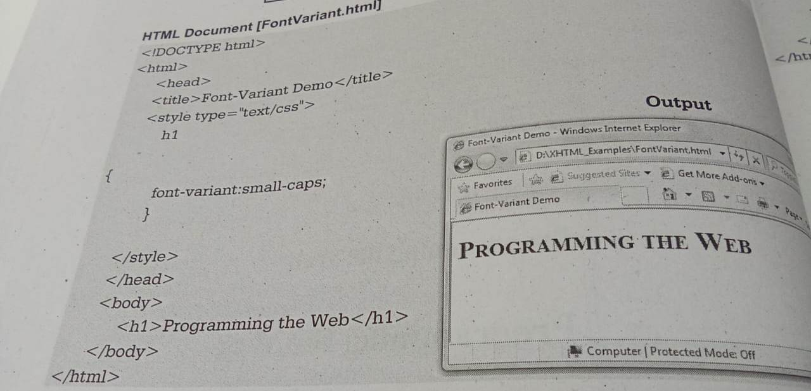

Slide 104
Font Weights
https://www.w3schools.com/cssref/pr_font_weight.php

Slide 105
Font shorthands
https://www.w3schools.com/css/css_font_shorthand.asp

Slide 106
Bootstrap
Bootstrap is a free front-end framework for faster and easier web development
Bootstrap includes HTML and CSS based design templates for typography, forms, buttons, tables, navigation, modals, image carousels and many other, as well as optional JavaScript plugins
Bootstrap also gives you the ability to easily create responsive designs
What is Responsive Web Design? Responsive web design is about creating web sites which automatically adjust themselves to look good on all devices, from small phones to large desktops.

Slide 107
Why Use Bootstrap?
Easy to use: Anybody with just basic knowledge of HTML and CSS can start using Bootstrap
Responsive features: Bootstrap's responsive CSS adjusts to phones, tablets, and desktops
Mobile-first approach: In Bootstrap 3, mobile-first styles are part of the core framework
Browser compatibility: Bootstrap is compatible with all modern browsers (Chrome, Firefox, Internet Explorer, Edge, Safari, and Opera)

Slide 108
Bootstrap Versions
This tutorial follows Bootstrap 3, which was released in 2013. However, we also cover newer versions; Bootstrap 4 (released 2018) and Bootstrap 5 (released 2021).
Bootstrap 5 is the newest version of Bootstrap; with new components, faster stylesheets, more responsiveness etc. It supports the latest, stable releases of all major browsers and platforms. However, Internet Explorer 11 and down is not supported.
The main differences between Bootstrap 5 and Bootstrap 3 & 4, is that Bootstrap 5 has switched to JavaScript instead of jQuery.

Slide 109
Create First Web Page With Bootstrap
Bootstrap uses HTML elements and CSS properties that require the HTML5 doctype.
Always include the HTML5 doctype at the beginning of the page, along with the lang attribute and the correct character set
Bootstrap is developed mobile first, a strategy in which we optimize code for mobile devices first and then scale up components as necessary using CSS media queries. To ensure proper rendering and touch zooming for all devices, add the responsive viewport meta tag to your <head>.
Charset: This is an attribute that tells your browser what character encoding to use for this webpage to show the content as desired.
UTF-8: This is a version of the character set.
<!DOCTYPE html> <html lang="en"> <head> <meta charset="utf-8"> </head> </html>

Slide 110
2. Bootstrap 3 is mobile-first
Bootstrap 3 is designed to be responsive to mobile devices. Mobile-first styles are part of the core framework.
To ensure proper rendering and touch zooming, add the following <meta> tag inside the <head> element:
<meta name="viewport" content="width=device-width, initial-scale=1">
The width=device-width part sets the width of the page to follow the screen-width of the device (which will vary depending on the device).
The initial-scale=1 part sets the initial zoom level when the page is first loaded by the browser.

Slide 111
3. Containers
Bootstrap also requires a containing element to wrap site contents.
There are two container classes to choose from:
The .container class provides a responsive fixed width container
The .container-fluid class provides a full width container, spanning the entire width of the viewport

Slide 112
Grid Classes
The Bootstrap grid system has four classes:
xs (for phones - screens less than 768px wide)
sm (for tablets - screens equal to or greater than 768px wide)
md (for small laptops - screens equal to or greater than 992px wide)
lg (for laptops and desktops - screens equal to or greater than 1200px wide)
Ex - https://www.w3schools.com/bootstrap/bootstrap_grid_basic.asp

Slide 113
Bootstrap Text/Typography
Bootstrap's Default Settings
Bootstrap's global default font-size is 14px, with a line-height of 1.428.
This is applied to the <body> element and all paragraphs (<p>).
In addition, all <p> elements have a bottom margin that equals half their computed line-height (10px by default).
Ex - https://www.w3schools.com/bootstrap/bootstrap_typography.asp

Slide 114
Bootstrap Tables
The <table> tag is used to create the table.
The <tr> tag is used for rows and <td> tag is used for columns.
The heading in the table can be denoted within <thead><th> </th></thead> tag while remaining contents of the table are specified in <tbody> tag
https://www.w3schools.com/bootstrap/bootstrap_tables.asp

Slide 115
Bootstrap images
Bootstrap Images - https://www.w3schools.com/bootstrap/bootstrap_images.asp
Bootstrap Buttons - https://www.w3schools.com/bootstrap/bootstrap_buttons.asp

Slide 116
Bootstrap Forms
Bootstrap provides three types of form layouts:
Vertical form (this is default)
Horizontal form
Inline form
Standard rules for all three form layouts:
Wrap labels and form controls in <div class="form-group"> (needed for optimum spacing)
Add class .form-control to all textual <input>, <textarea>, and <select> elements
Ex. - https://www.w3schools.com/bootstrap/bootstrap_forms.asp

